Slide 1
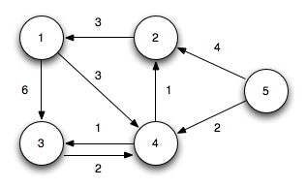
Dijkstra's Algorithm Implementation using Java
Finding the Shortest Paths in a Graph
Prepared By:
Rana Jaydip
C9 | 473 | CST
Enro. No.:
22002171310112
This Photo by Unknown Author is licensed under CC BY-SA

Slide 2
What is Dijkstra's Algorithm?
Definition: Dijkstra's algorithm is a popular algorithm for finding the shortest paths between nodes in a graph.
Applications:
Routing and navigation systems.
Network analysis.
Game pathfinding algorithms.

Slide 3
Applications and Use Cases
Routing Algorithms: GPS navigation (e.g., Google Maps).
Network Optimization: Finding optimal paths in communication networks.
Game Development: Pathfinding in game maps.
Scheduling and Logistics: Optimizing delivery routes.

Slide 4
Future Scope
Integration with Real-World Applications
Support for Dynamic Graphs
Multi-Criteria Optimization
Logistics and Supply Chain
Applications in Robotics and Automation

Slide 5
Thank You..

